Slide 1

Middletown Athletics
GO CAVS!!

Slide 2
Middletown High Athletic Staff
Athletic Director & Athletic Trainer: Colleen Kelley
Assistant Athletic Director: Zach Watchilla & Steve Byers
Supervisor of Athletics: Joe Lahutsky

Slide 3
Medical Staff
Tyesha Alston MS,LAT ATC – Athletic Trainer, Premier PT
Colleen Kelley- Athletic Trainer
Dr. Jeremie Axe, Team Physician, First State Orthopedics
School Nurses- Gail Moyer & Laurie Garrison
Abby Go Care- Newark- Primary walk in clinic

Slide 4
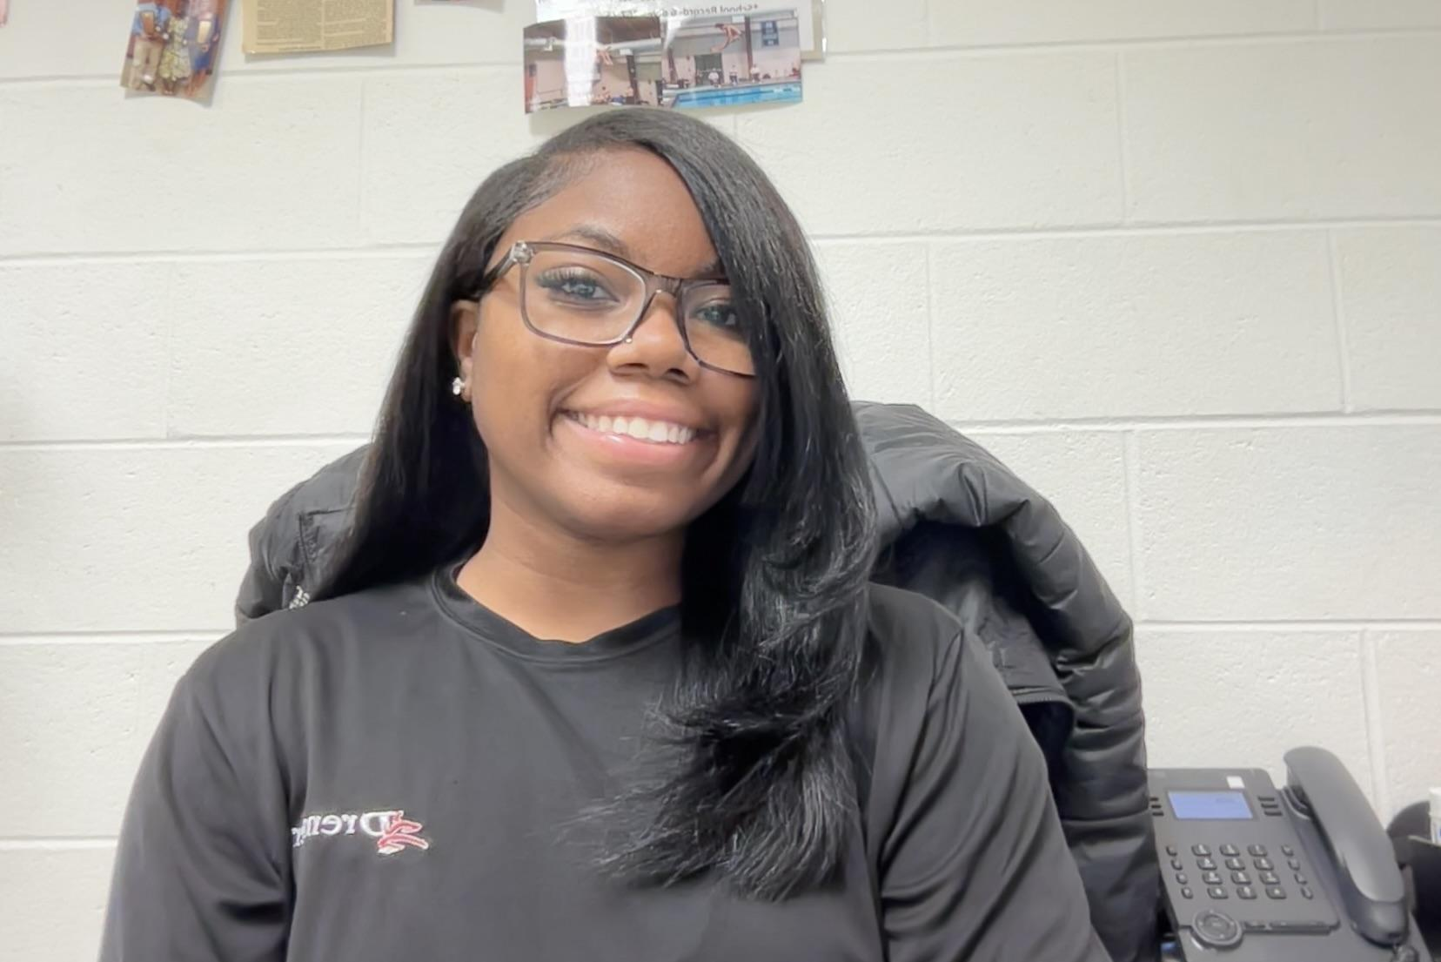
Injuries
If a player has an injury, PLEASE reach out to Ms. Ty FIRST before going to a doctor or clinic
Ms. Ty’s office is open at 2pm every day
Strongly encourage your athlete to utilize our medical staff to their advantage during practice hours
MUST have a doctor's note to return to play!
Parents can get in touch with Ms.Ty via Band
Make sure it is the parent information in snap manage

Slide 5
Game Schedule:
https://www.cavalierssports.com/
Game schedule is posted for all teams
most up to date location for games
Also location where you can find Coaches information if needed
Sign up for the Updates on the homepage
Transportation to away games- ride bus to and from

Slide 6
Rank One
Reminder: parents have agreed to our media/photography and transportation policies in addition to our athletic participation agreements.

Slide 7
Practice Information:
Late Buses: There is an activity bus provided for student-athletes that practice after school at MHS. The bus departs at 6pm. Check Cavs sports website for details.
Locker Room Access: All players have access to the gym locker rooms. They must provide a lock to lock up any equipment. They must get here before 1st period to store their equipment.
Field rotation: We rotate which field we use on each week. If your team is at the Stadium, players carpool to the stadium or parents must transport, but must have transportation home from stadium.

Slide 8
Coach/Player/Parent Communication:
Chain of Command: if an issue or problem, please follow the Chain of Command.
Player MUST contact coach IN PERSON to advocate for themselves & discuss their concerns.
Parents may then contact the Coach if they feel that is necessary.
If further assistance is needed the Athletic Director will be notified & beyond.
At no time should a player, parent or Coach reach out to the district or the DIAA without going to the AD first.
Must follow the 24 hour rule to discuss any concerns
A Coach MAY NEVER be approached at a game or practice to discuss a matter
Band App: Communication about everything will be pushed out through this App. Must have 1st name & Last name and “parent of “
Also feel free to Email the Coach if needed
BUT Athletes should be communicating with Coaches 1st

Slide 9
Player Expectations: Respect Love Honor --The Game
A team first attitude- unselfish, positive, encouraging, and supportive
A coachable attitude- willing to listen, improve, and accept constructive criticism
A loyal commitment to Middletown Athletics, supporting all teammates and coaches and other teams.
A commitment to give your very best effort, every day-every play
Be self-motivated and self disciplined
Follow all school, classroom, and team rules
Be a positive role model- you represent Middletown at all times
Understand and accept your role on the team

Slide 10
Academic Eligibility
DIAA policy- passing 5 credits
Appo policy- Must have a 2.0 GPA on report card from the previous MP
If you do not have a 2.0 you must do weekly tutoring (academic waiver) in order to maintain eligibility throughout the next marking period.
Coaches will be sent out a list of athletes who are on waivers for each sport once rosters are submitted. Coaches are responsible for relaying information to athletes
At any point a Coach can decide to focus on academics for a particular player

Slide 11
Fall Sports Picture Days Coming Soon- info for ordering will be sent out on band
Friday 9/11:
Unified Flag Football 3pm
Cross Country- 3:30 pm (Media Day on 9/15 at 10 am in the gym)
Field Hockey- 3:45 pm
Volleyball- 4:00 pm (JV and freshman only)- Varsity had media day
Saturday 9/12
Soccer 10 am (Media Day on 9/15 am at 11 am in the gym)
Cheer (JV only) 10:30 am- Varsity had media day
Football 11:30 am (Freshman, JV, and varsity)

Slide 12
DIAA Policies
Attendance- Must be present for half of the school day- does not matter if it excused or unexcused.
Transfers Must be approved by DIAA through Rank One
If you move during the season (or school year) you must notify the front office and the athletic director. This could affect eligibility.

Slide 13
Reminders at Games
Cheer like CRAZY for our Cavaliers! Be Loud & Proud
DO NOT Coach from the sidelines…..we have coaches for that!
DO NOT officiate from the stands! We have officials for that! No booing, heckling, complaining. Let the head Coach defend us.
Remember to never call out players. That is someone’s child and they are just kids
The officials are human beings and THEY WILL make mistakes and bad calls. Move on!

Slide 14
Spectator Expectations: Respect Love Honor-- The Game
BE INFORMED OF THE PLAYING RULES OF THE SPORT.
APPRECIATE A GOOD PLAY REGARDLESS OF WHO MAKES IT.
SHOW CONCERN FOR AN INJURED ATHLETE REGARDLESS OF TEAM AFFILIATION.
DO NOT TAUNT, JEER, OR ATTEMPT TO DISTRACT THE MEMBERS OF THE OPPOSING TEAM.
AVOID THE USE OF PROFANITY AND DEROGATORY OR DISRESPECTFUL YELLS, CHANTS, SONGS OR GESTURES
RESPECT SCHOOL PROPERTY AND THE AUTHORITY OF SCHOOL OFFICIALS.
DO NOT PUBLICLY CRITICIZE THE COACHES OR ATHLETES FOR THE LOSS OF A CONTEST.
DO NOT CONFRONT A CONTEST OFFICIAL DURING INTERMISSION OR AFTER THE GAME.
RESPECT THE CONTEST OFFICIALS AND ACCEPT THEIR DECISIONS WITHOUT PUBLIC PROTEST. RECOGNIZE THAT WITHOUT THEM WE DO NOT HAVE A GAME.
DO NOT APPROACH A PLAYER DURING A GAME UNLESS TO DROP OFF SOMETHING NEEDED FOR THE GAME

Slide 15
Zero Tolerance for Poor Sportsmanship
Consequences of Poor Sportsmanship can include:
Meetings with students, parents, admin, coaches
Completion of NFHS courses before RTP
Game Suspensions
Removal from the team
Profanity, Booing, or Heckling, inappropriate remarks or gestures, yelling at a student athlete by name or number. Repeatedly yelling at an official or coach during a game are unacceptable and will not be tolerated at MHS

Slide 16
District Game Policies- Know before you go- check schedules
Ticketed Events
Bag Policy
Media Policy
Cavs Sports Home page

Slide 17
Practices!!
Practice is not optional
If you’re not at practice you can’t expect to play!
*Communication is key! Students need to communicate with coaches

Slide 18
Playing time
Please keep in mind the coaches are the ones putting in countless hours evaluating each student each day. They decide who plays and when and how it benefits the WHOLE team. While a parent is focused on only their child, the coach must think about the TEAM.
Although our coaches strive to get everyone into the games, at the high school level, there will be games where everyone does not play!

Slide 19
Questions???
We look forward to a FANTASTIC SEASON! Go Cavs!
Time For Team Breakout Rooms! No Unified football tonight- please stay in the main room if you have questions.

